Slide 1

6
A Guide to MySQL

Slide 2
Objectives
Create a new table from an existing table
Change data using the UPDATE command
Add new data using the INSERT command
Delete data using the DELETE command

Slide 3
Objectives (continued)
Use nulls in UPDATE commands
Change the structure of an existing table
Use the COMMIT and ROLLBACK commands to make permanent data updates or to reverse updates
Understand transactions and the role of COMMIT and ROLLBACK in supporting transactions
Drop a table

Slide 4
Creating a New Table from an Existing Table
Can create new table from existing table
Use CREATE TABLE command
Create SELECT command to select desired data
Can add query results to table by placing SELECT command in an INSERT command

Slide 5
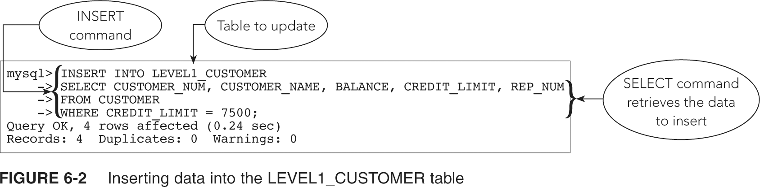
Creating a New Table from an Existing Table (continued)

Slide 6
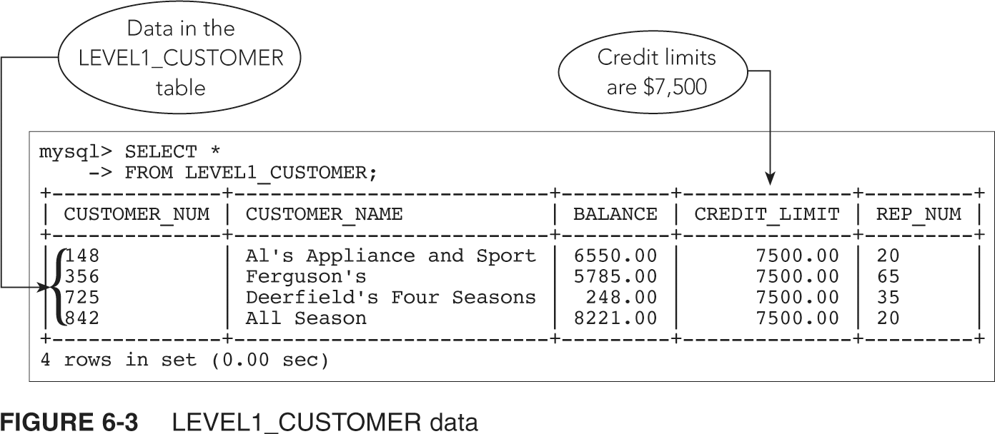
Creating a New Table from an Existing Table (continued)

Slide 7
Changing Existing Data in a Table
Use UPDATE command to change rows for which a specific condition is true; simple or compound condition
Command format:
  UPDATE (name of table to be updated)
  SET (name of the column to be
  updated = new value); can include a calculation

Slide 8
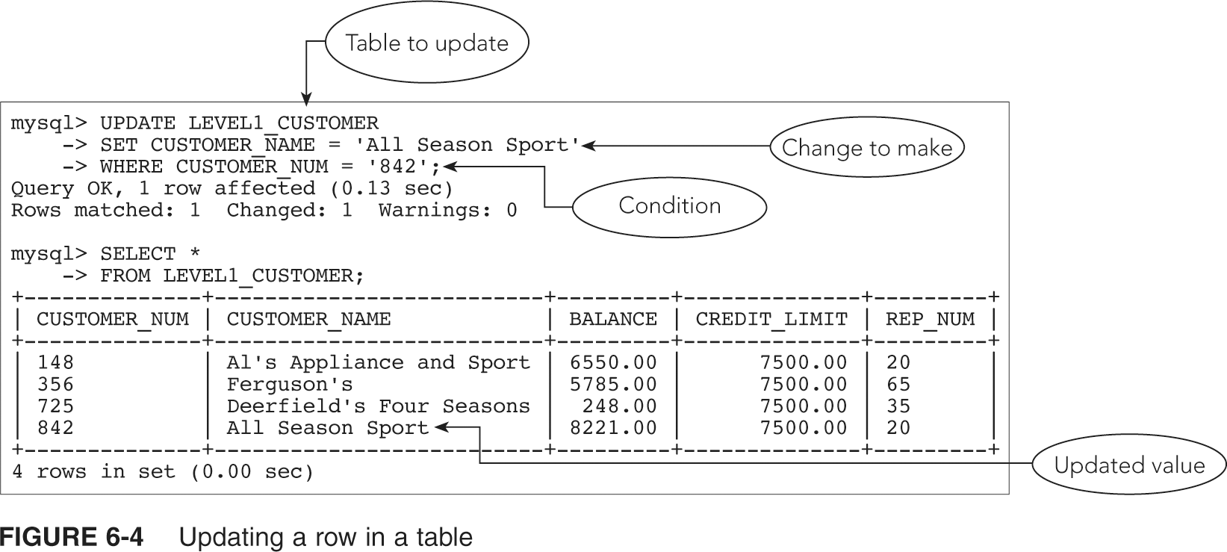
Changing Existing Data in a Table (continued)

Slide 9
Adding New Rows to an Existing Table
Use the INSERT command to add additional data to a table
Use SELECT to verify rows were added correctly

Slide 10
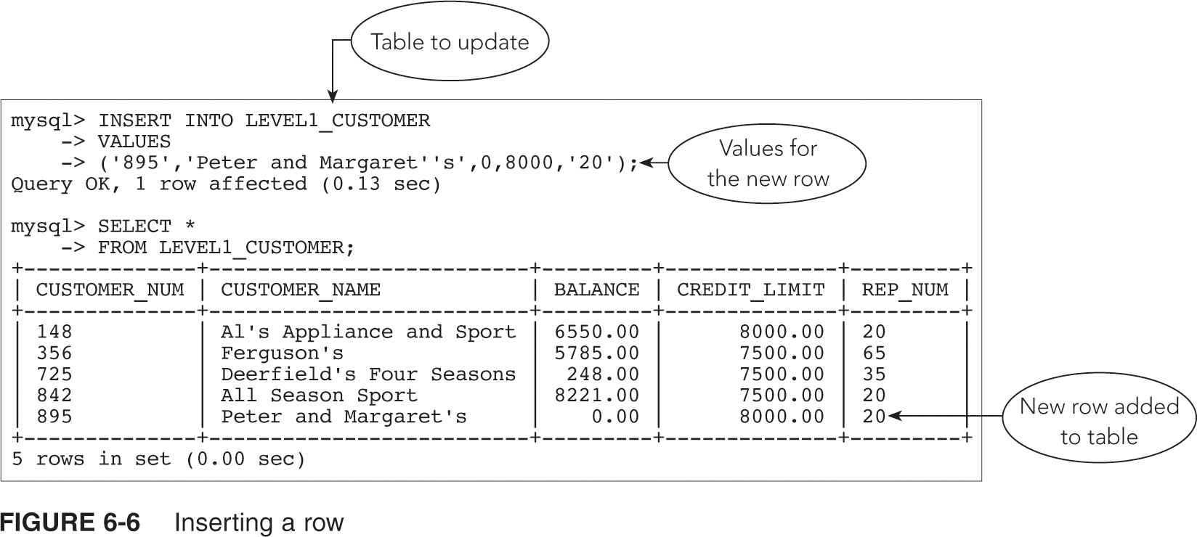
Adding New Rows to an Existing Table (continued)

Slide 11
Delete Existing Rows from a Table
Use DELETE command to delete data from database
Command format:
  DELETE (table from which the row(s) is to be deleted)
  WHERE clause (with a condition to select the row(s) to delete)
All rows satisfying the condition will be deleted
If no condition then all rows deleted

Slide 12
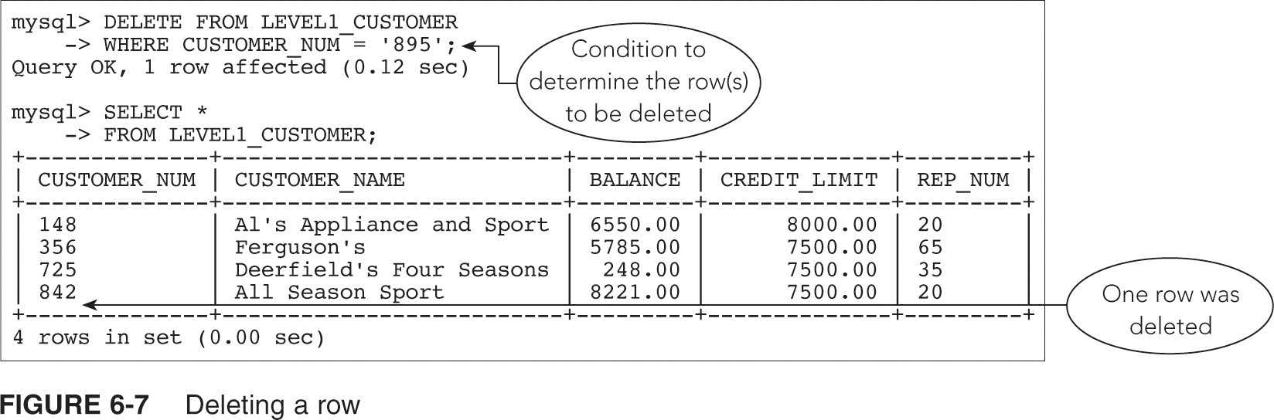
Delete Existing Rows from a Table (continued)

Slide 13
Changing a Value in a Column to Null
Command for changing value to null is same as changing any other value
Affected column must be able to accept nulls
Use the value NULL as the replacement value

Slide 14
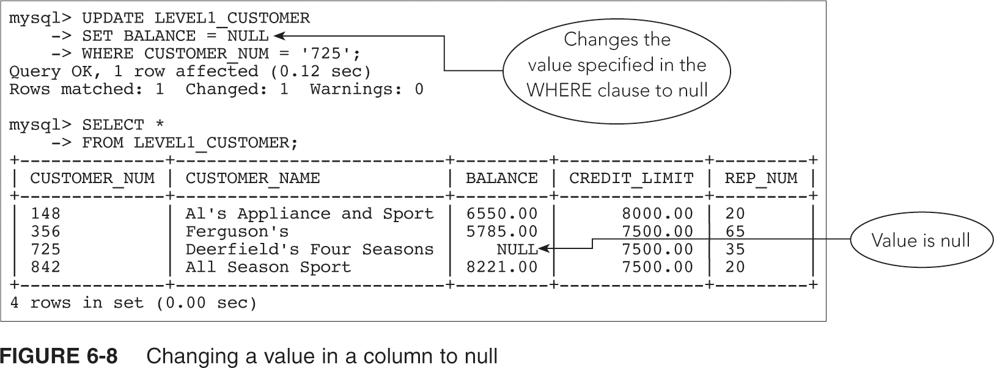
Changing a Value in a Column to Null (continued)

Slide 15
Changing a Table’s Structure
MySQL allows changes to table structure:
  Add new tables
  Delete tables no longer required
  Add new columns to a table
  Change physical characteristics of existing columns

Slide 16
Changing a Table’s Structure
ALTER TABLE command allows for changing a table’s structure
Use ADD clause to add a new column; ADD clause is followed by the name of column to be added, followed by its characteristics

Slide 17
Changing a Table’s Structure (continued)
Assign value to new column: simplest approach is to assign NULL as the value
Or use an UPDATE command:
  Change all rows to most common value
  Change individual rows

Slide 18
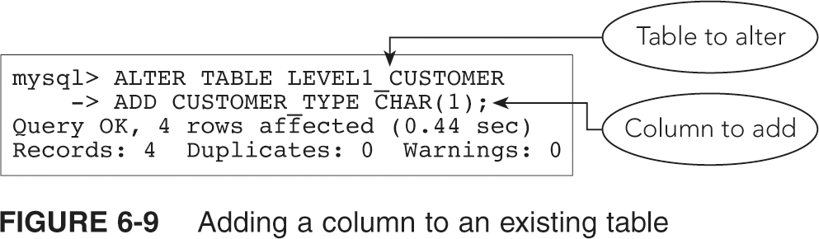
Changing a Table’s Structure (continued)

Slide 19
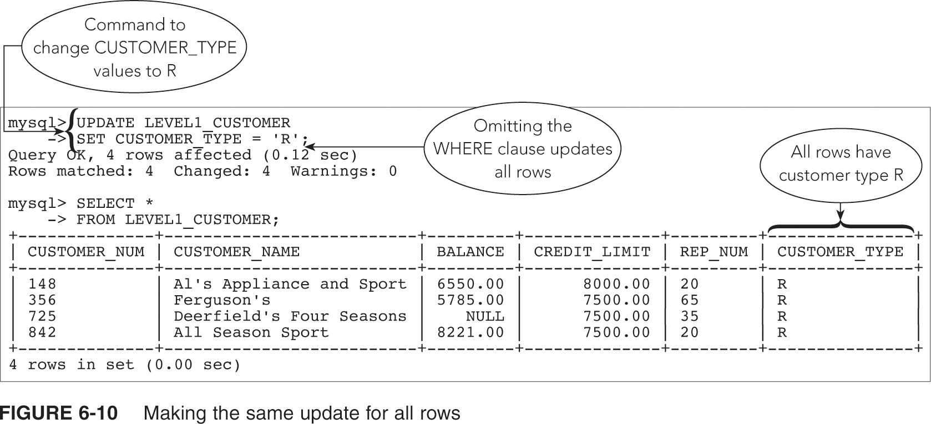
Changing a Table’s Structure (continued)

Slide 20
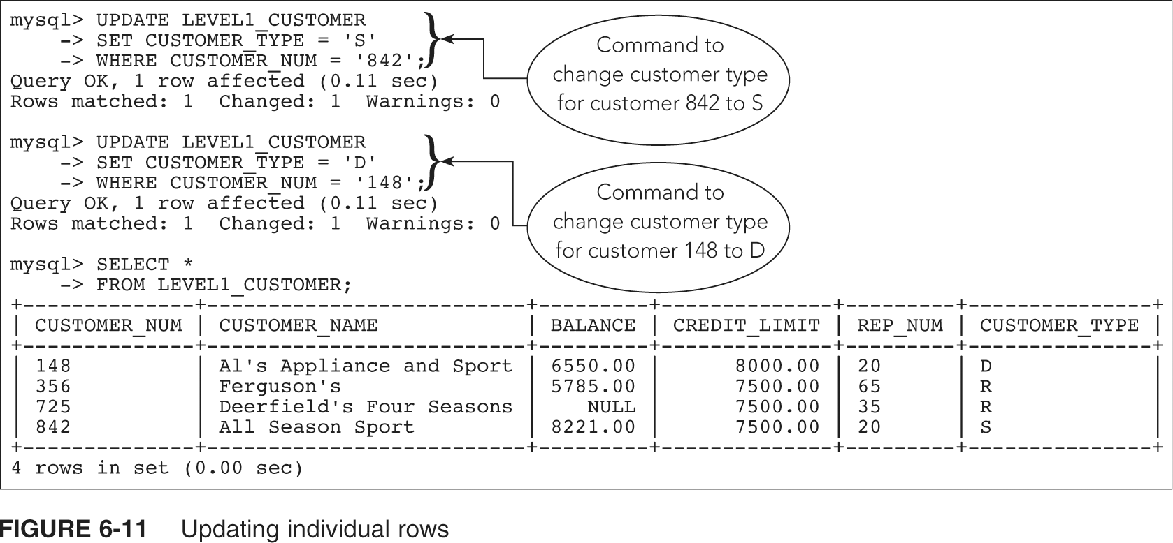
Changing a Table’s Structure (continued)

Slide 21
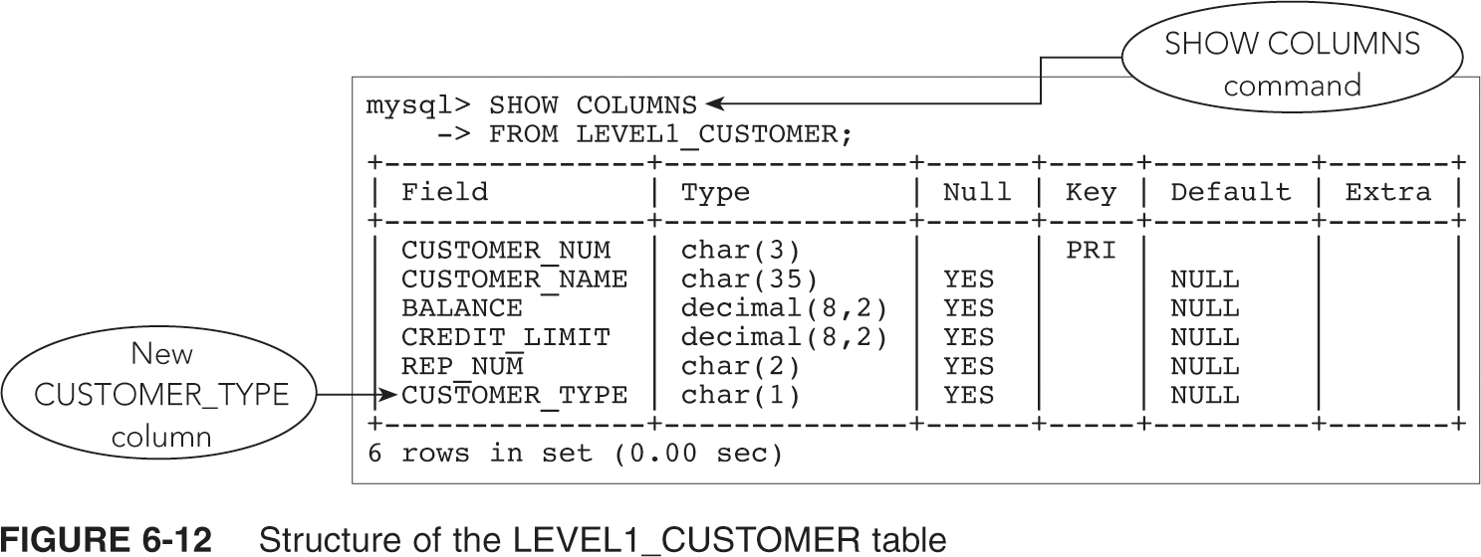
Changing a Table’s Structure (continued)

Slide 22
Changing a Table’s Structure (continued)
MODIFY clause of ALTER TABLE command changes characteristics of existing columns
Can use to change a column that currently rejects null values; use NULL in place of NOT NULL
Can increase and decrease size of column

Slide 23
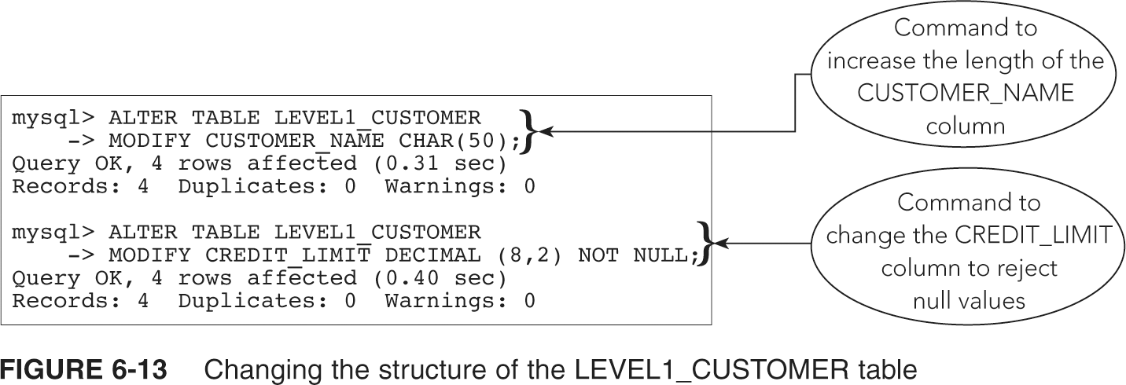
Changing a Table’s Structure (continued)

Slide 24
Making Complex Changes
Changes to table structure may be beyond the capabilities of MySQL:
  Eliminate multiple columns
  Change column order
  Combine data from two tables to one
Create a new table

Slide 25
COMMIT and ROLLBACK
Updates to a table are only temporary; can cancel during current work session
COMMIT command: saves changes immediately during current session
ROLLBACK command: reverses the changes made since last COMMIT command or in current work session

Slide 26
COMMIT and ROLLBACK (continued)
ROLLBACK command only reverses changes made to data
COMMIT command is permanent: running ROLLBACK after COMMIT cannot reverse the update
In MySQL must change value for AUTOCOMMIT:
  SET AUTOCOMMIT = 0;

Slide 27
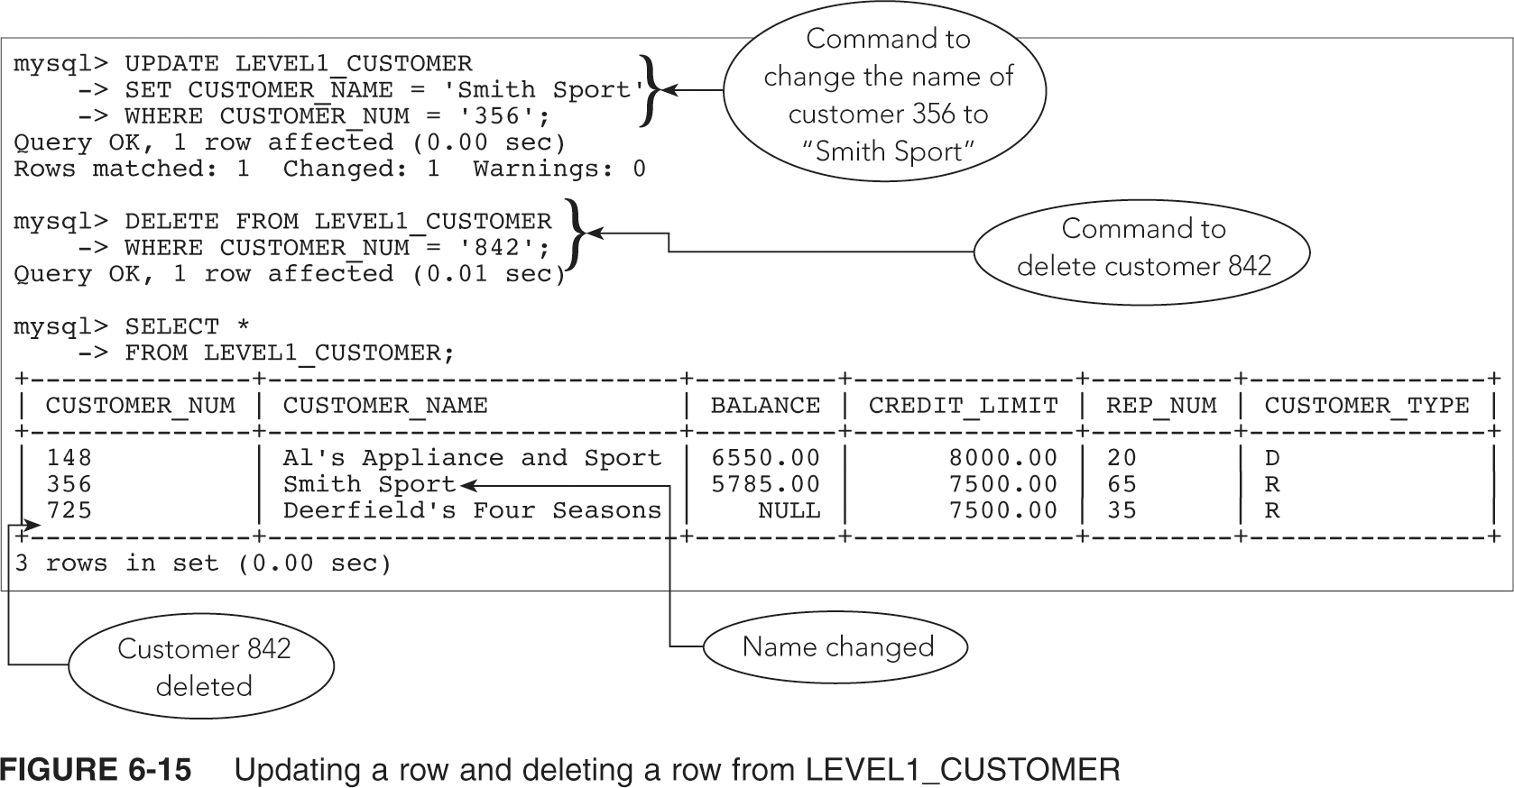
COMMIT and ROLLBACK (continued)

Slide 28
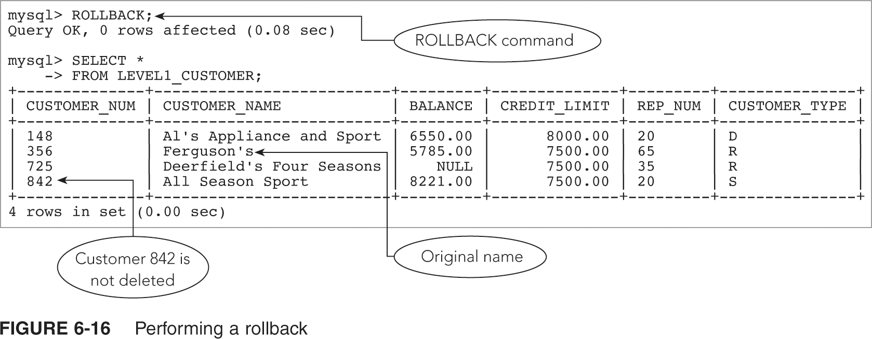
COMMIT and ROLLBACK (continued)

Slide 29
Transactions
A transaction is a logical unit of work:
  Sequence of steps that accomplish a single task
  Essential that the entire sequence be completed successfully
COMMIT and ROLLBACK commands support transactions

Slide 30
Transactions (continued)
Before starting updates for a transaction, COMMIT any previous updates
Complete the updates for the transaction; if it cannot be completed, use ROLLBACK
If all updates complete, use COMMIT again

Slide 31
Dropping a Table
Use DROP TABLE command to delete a table
Permanently removes table and all its data from database

Slide 32
Summary
Use CREATE TABLE command to make a new table from an existing table
Use UPDATE command to change data
Use INSERT command adds new rows
Use DELETE command to delete existing rows from a table
Use SET clause:
  To make values NULL
  Change specific value to null with a condition

Slide 33
Summary (continued)
Use ALTER TABLE command with ADD clause to add a column to a table
Use ALTER TABLE command with MODIFY clause to change column characteristics
Use COMMIT command to make changes permanent
Use ROLLBACK command to reverse updates
Use DROP TABLE command to delete a table and its data

